Slide 3
BESS
1
L4
L6
L7
G1
L3
BESS2
PV
L8
L2
L5

Slide 4
BESS
1
L4
L6
L7
G1
L3
BESS2
PV
L8
L2
L5

Slide 5


L6
L7
G1
BESS 1
L3
L4
BESS 1
L8
L2
L5
BESS 2
PV

Slide 6
Lines, load sections, switches, BESSs, PV, and generator color
Switch shape
Load section shape
Load sections, BESSs, PV, and generator locations
Protection color (block, temperate, permanent fault)
Sub MGs
Load section numbers

Slide 7
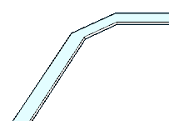
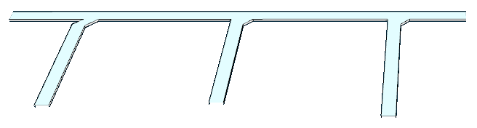

Slide 8
